Slide 1
EE 1100: Intro to EE lab

Slide 2
Lab safety
Voltage and current
Ohm’s Law
Basic circuit elements: Resistors and Potentiometers
Digital multimeters
Make your own resistor
Basic circuit elements: Batteries and LED
Breadboards
Lab activity: Circuits 1 and 2

Slide 3
Meet your TAs!
Office Hours: TBD
If you have any questions or concerns, please send us an email with the class name in the subject line!

Slide 4
TA 1
Put information/pics of yourself here!

Slide 5
TA 2
Put information/pics of yourself here!

Slide 6

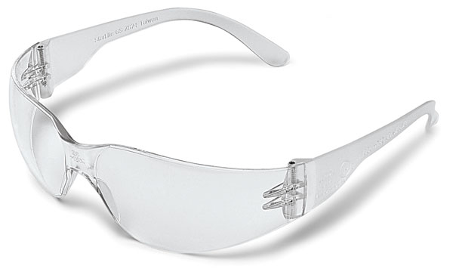

Lab Safety
All photos are by Unknown Author and are licensed under CC BY-ND
This Photo by Unknown Author is licensed under CC BY-SA

Slide 7
Voltage vs. Current
Voltage is the energy per unit charge created by an imbalance of charge. The units of voltage are volts [V].
Current is the rate of change in the flow of electrons. The unit of current is Amperes or Amps [A]

Slide 8
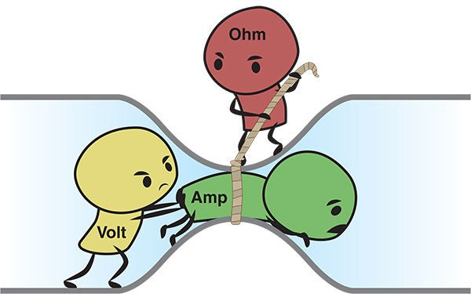
Ohm’s LAW
Ohm’s Law describes the relationship between resistance, voltage and current.
V=I∙R
Source: https://www.instructables.com/id/Ohms-Law-for-Dummies/

Slide 9
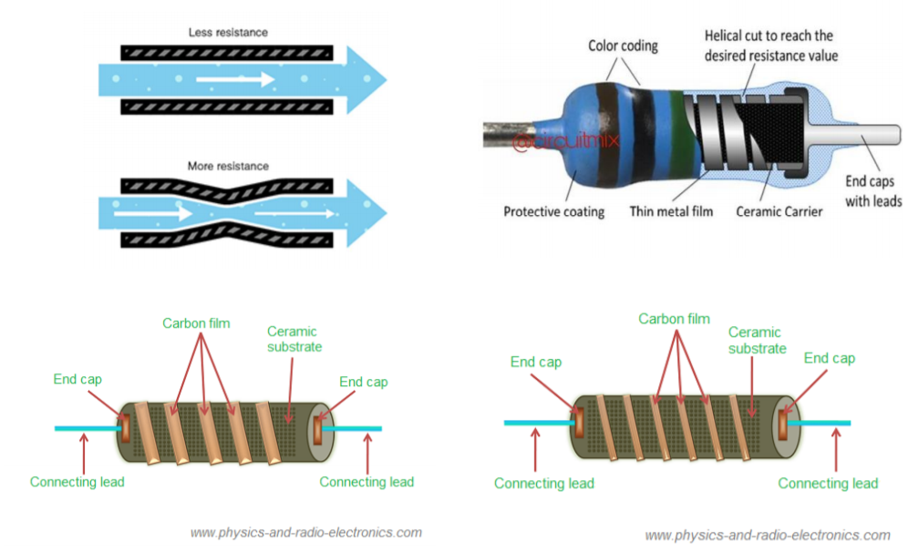
Resistor
A resistor is a circuit element that limits the flow of current. Resistors turn electric energy into heat (power dissipation).

Slide 10
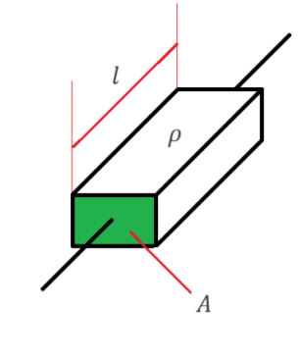
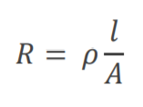
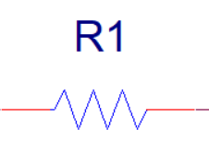
Resistor
R: resistance [Ω]
𝜌 (𝑟ℎ𝑜): resistivity (depends on the material) [Ω.m]
l: length of the conductor [m]
A: cross-sectional area of the conductor [𝑚2 ]
Circuit schematic symbol

Slide 11
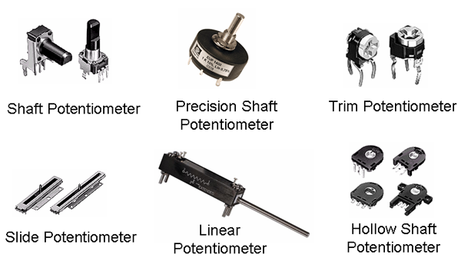
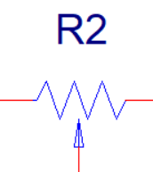
Potentiometer
A potentiometer is a variable resistor.
Circuit schematic symbol
Source: http://hades.mech.northwestern.edu/index.php/Potentiometers

Slide 12
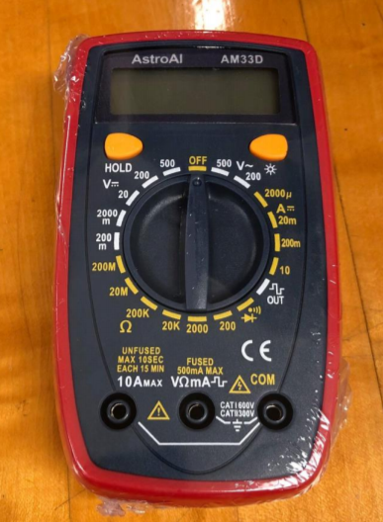
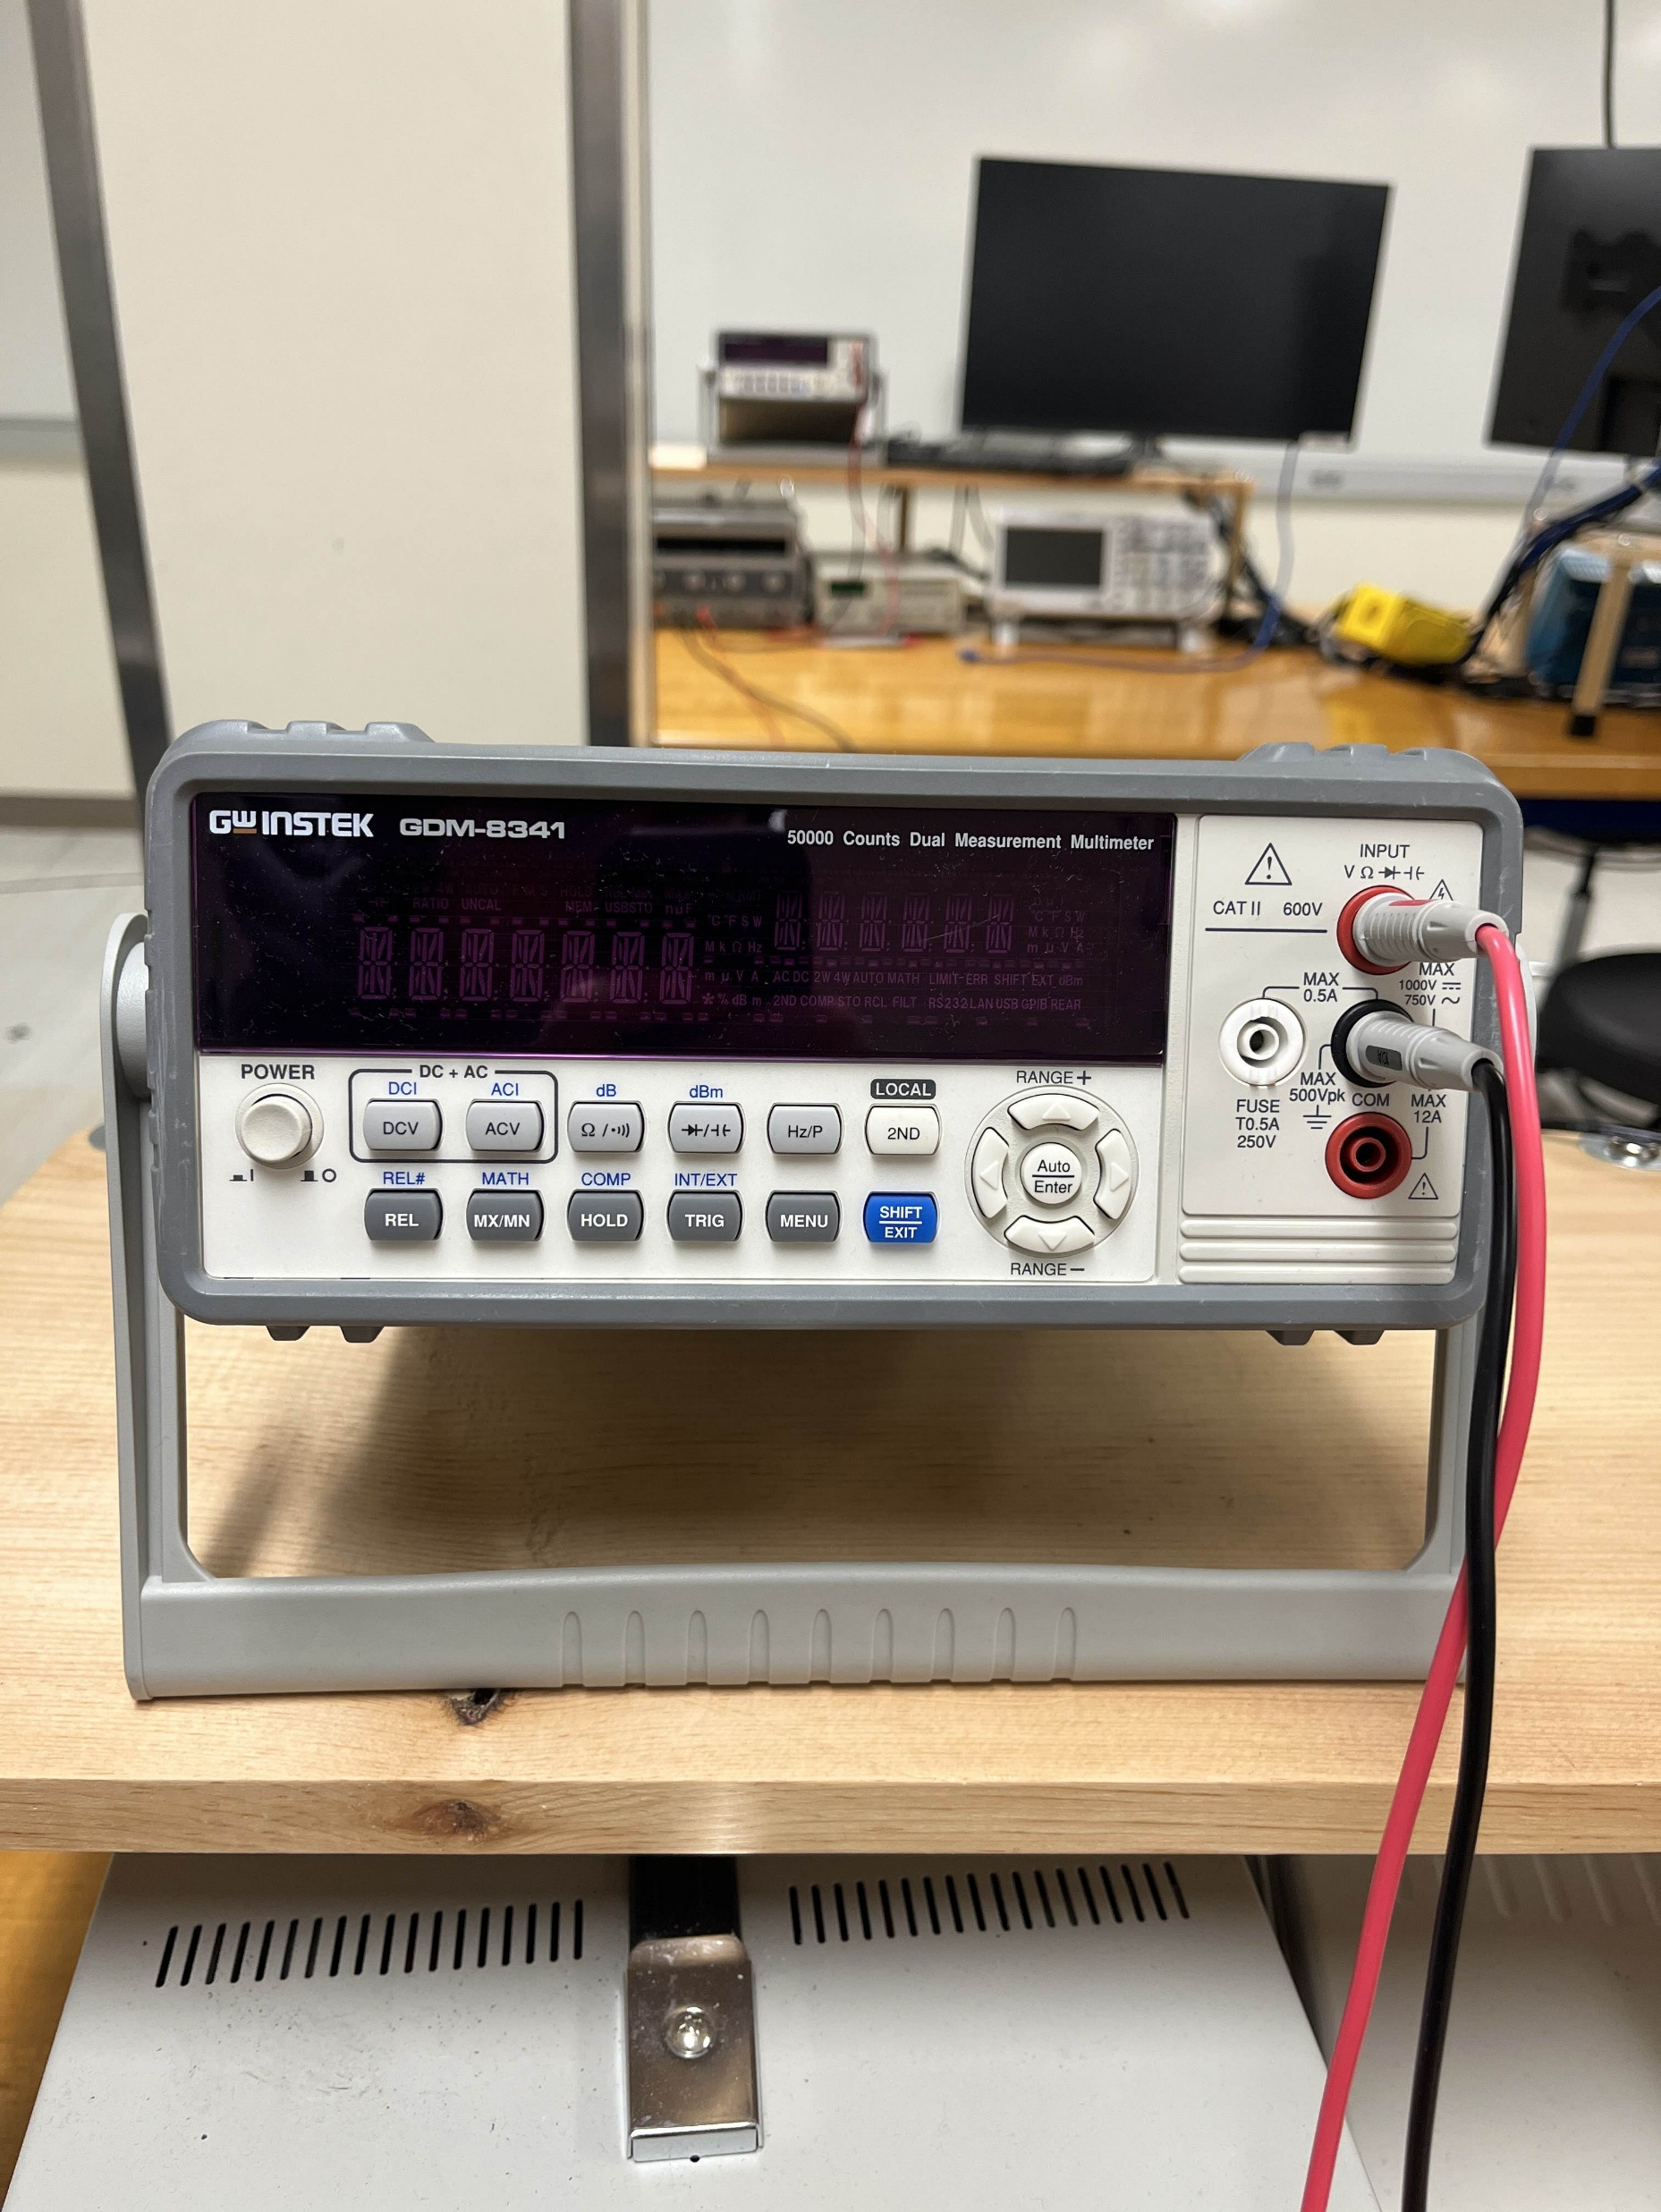
Digital Multimeter (DMM)

Slide 13
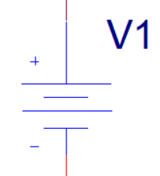
Battery
A battery is a device comprised of cells that are used to power electrical devices. Batteries act as a voltage supply for many circuits.
Circuit schematic symbol

Slide 14
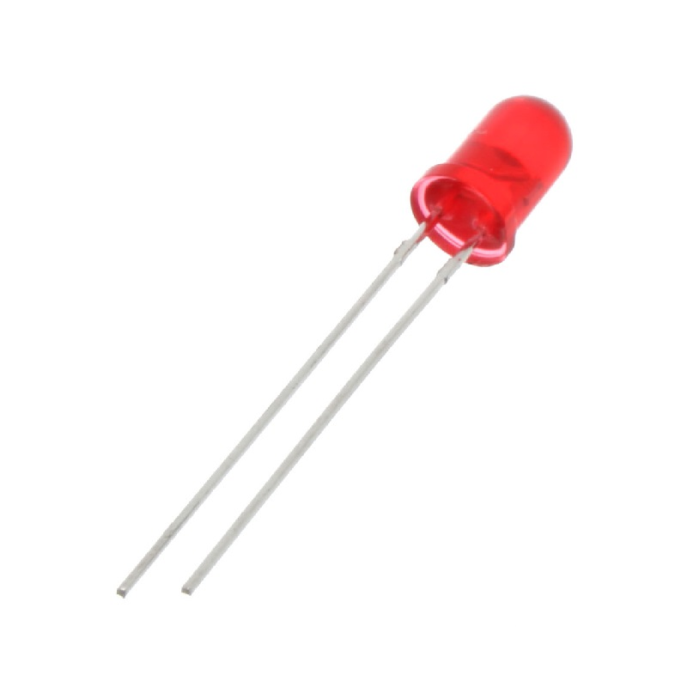
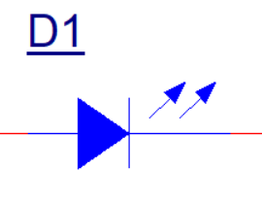
LED (Light Emitting Diode)
A diode is a circuit element the only allows current to flow in one direction. An LED will emit light when current is flowing through the diode.
1: anode (positive leg)
2: cathode (negative leg)
1
2
1
2
Source: https://www.studentcompanion.co.za/product/led-red-5mm/

Slide 15
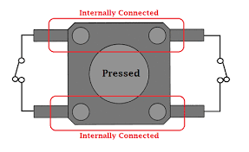
Pushbuttons!

Slide 16
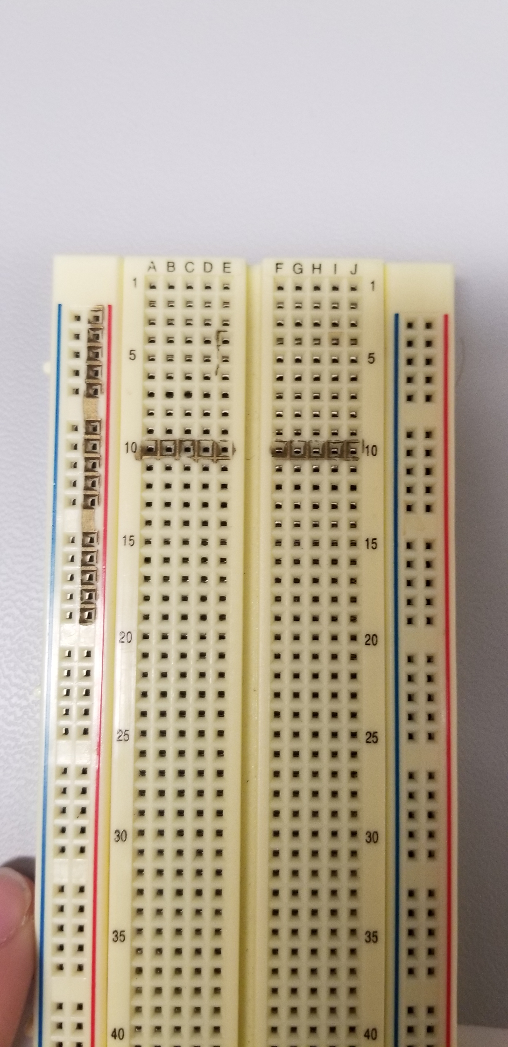
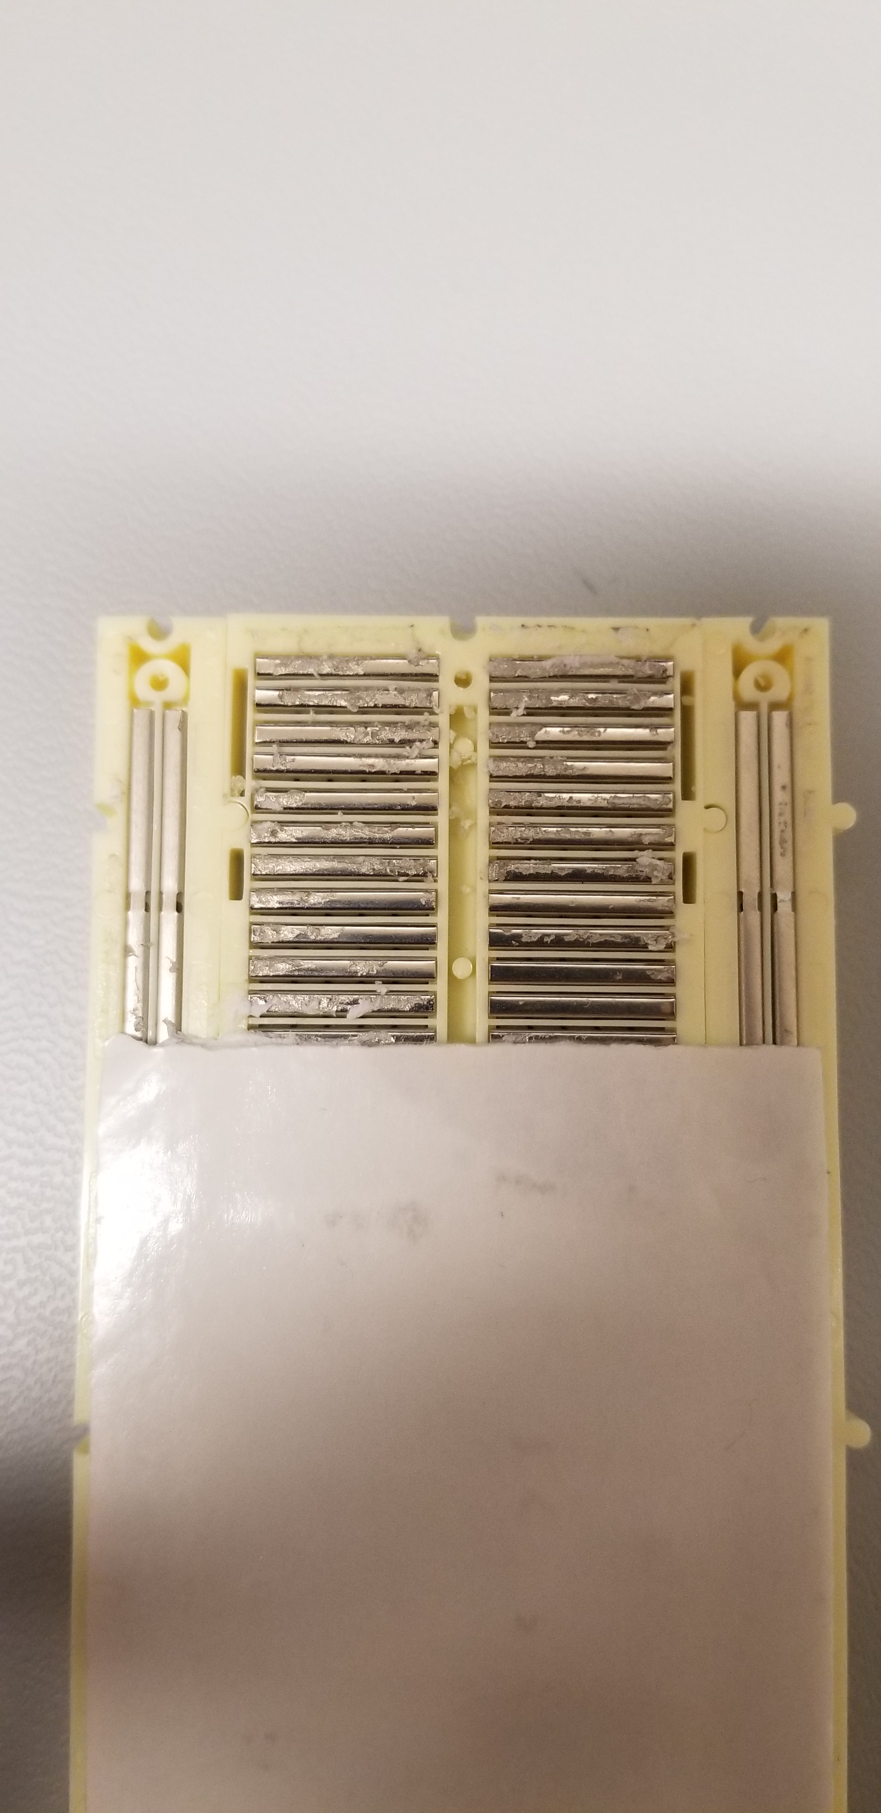
Breadboard

Slide 17
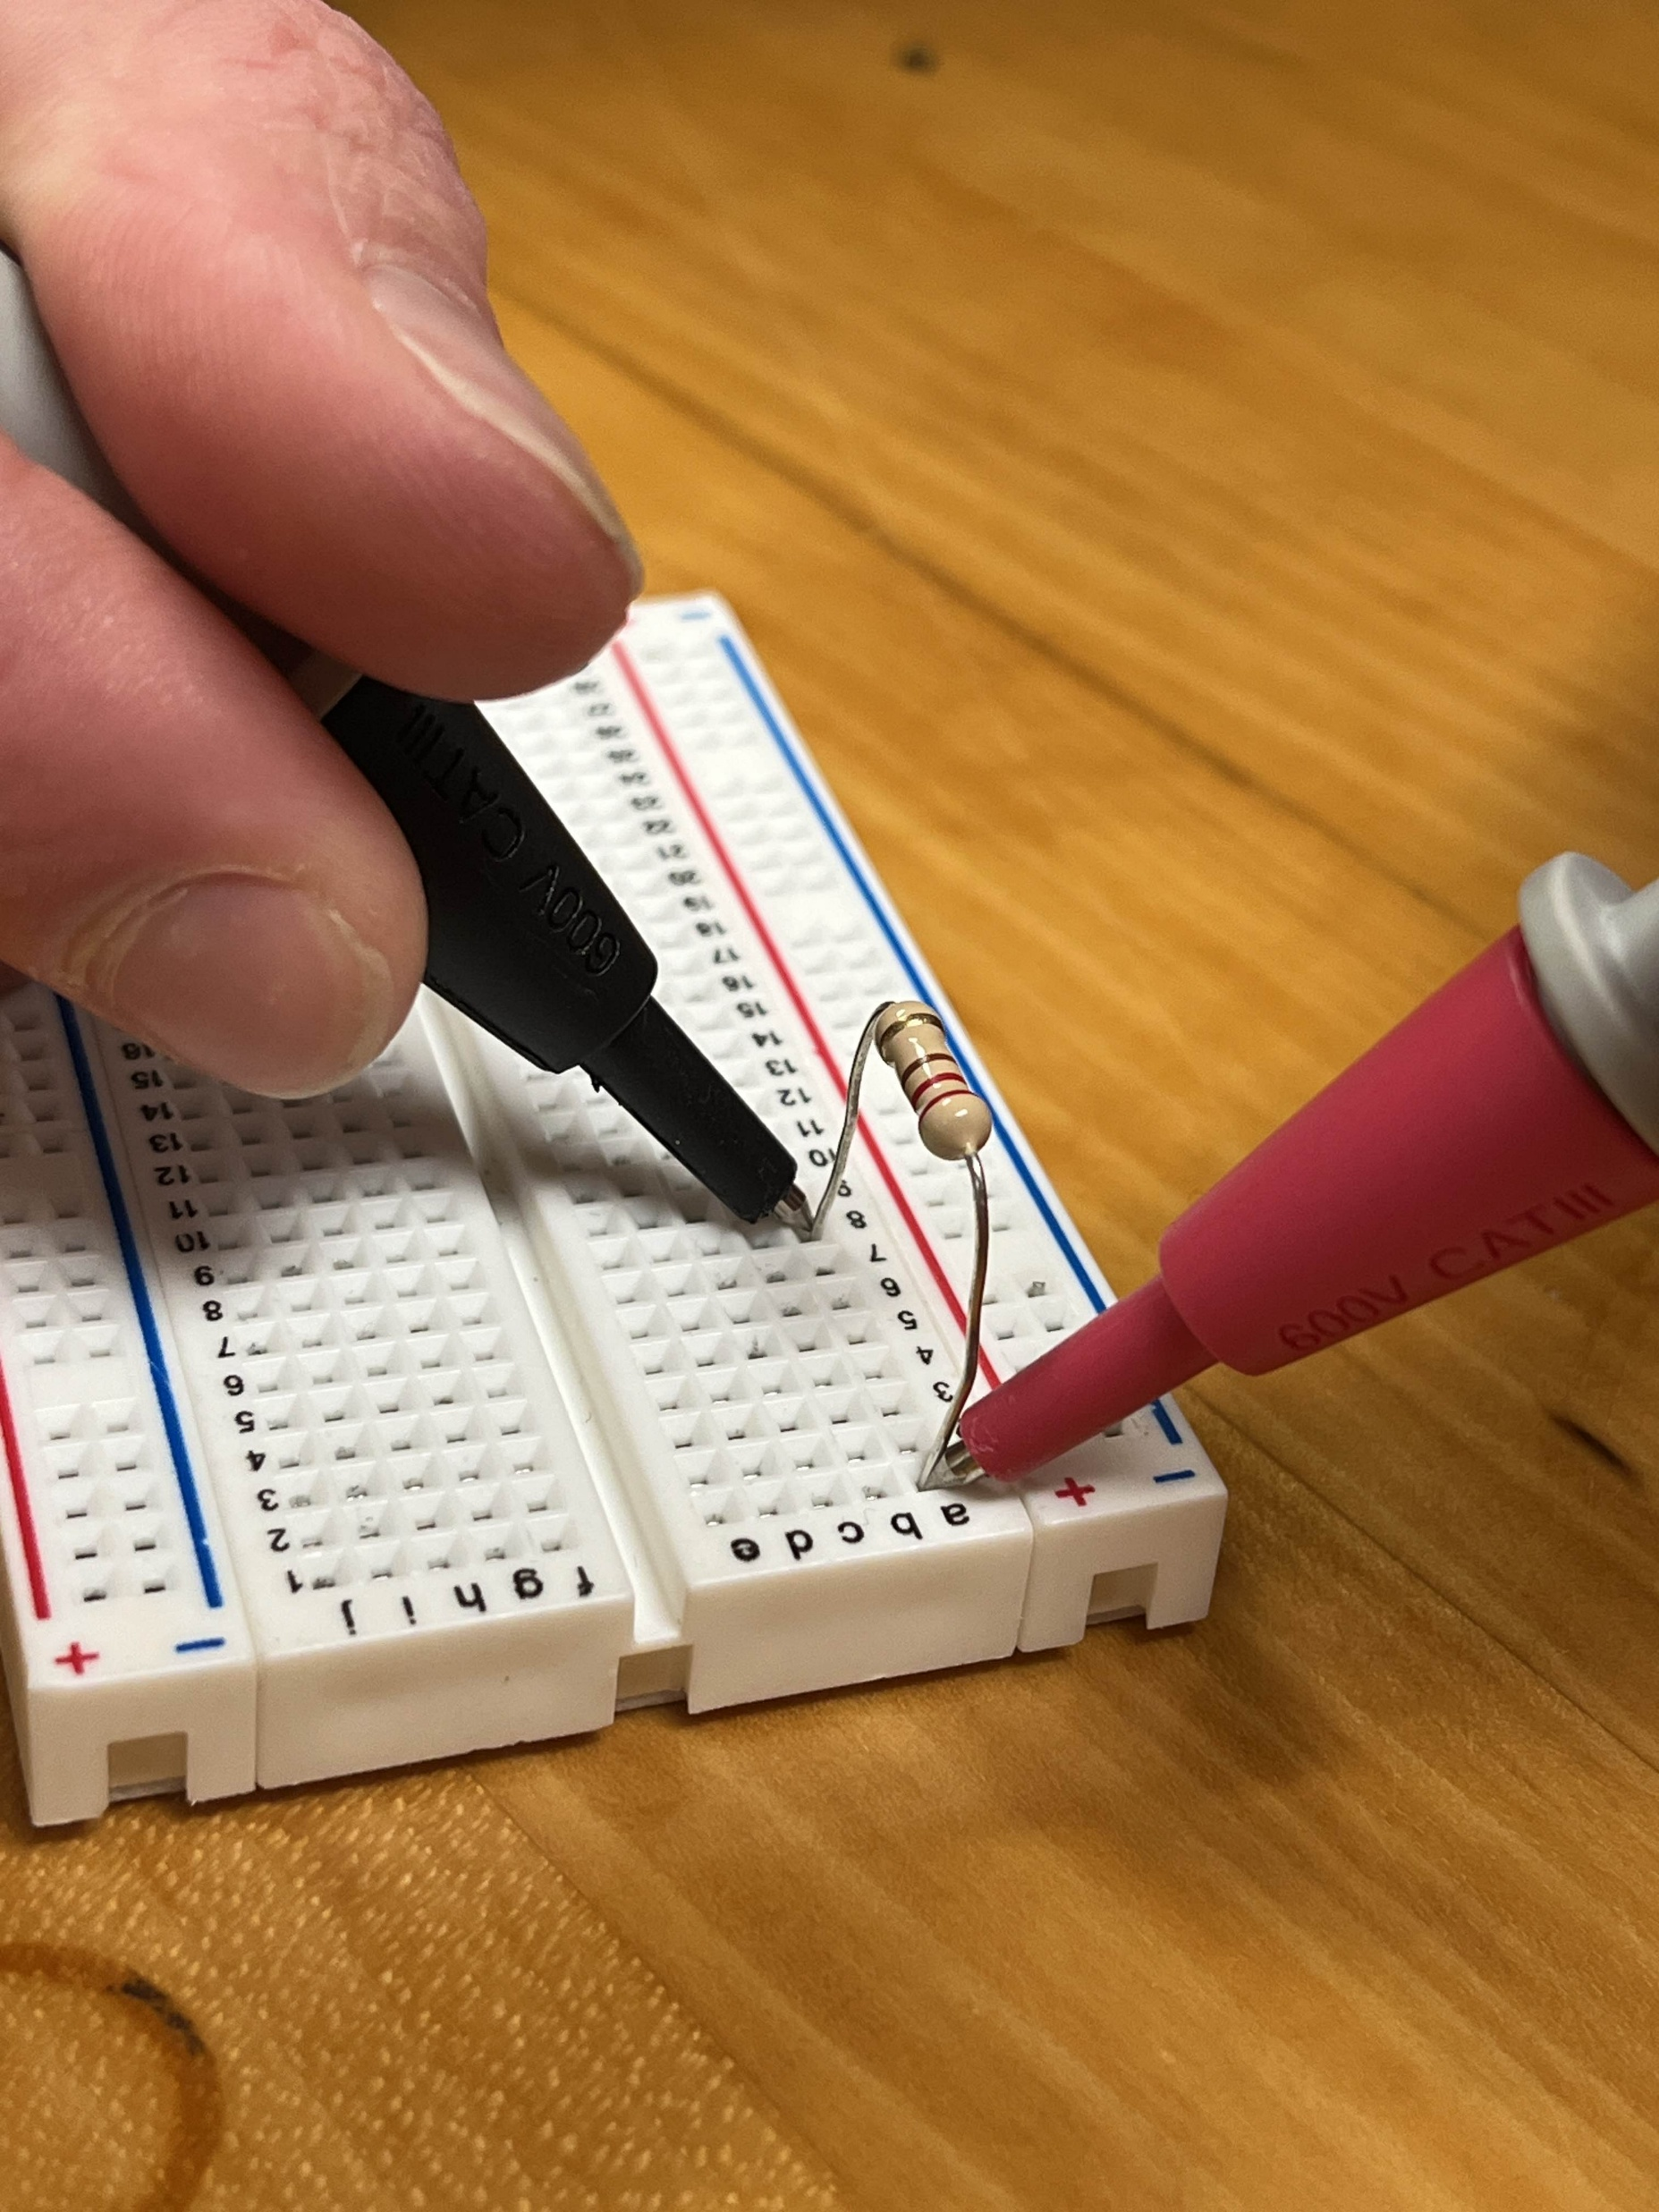
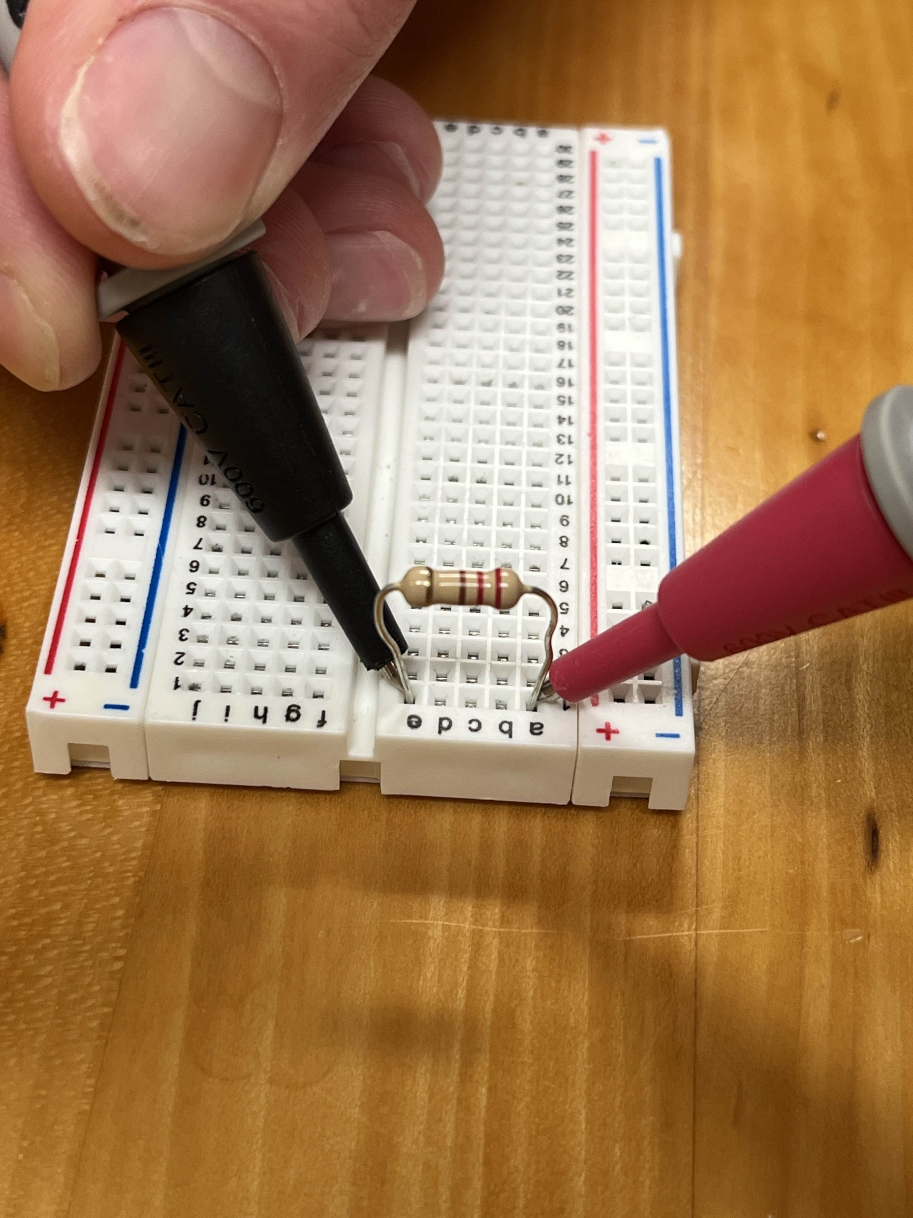
Measuring Voltage/Resistance (Parallel)!
Correct!!
WRONG

Slide 18
Using the Power Supply
1) Turn on the power supply
2) Turn the current knob all the way to the right (unless you want to limit to a specific current)
3) Ensure the buttons are configured so the supply is in “Independent” mode
4) Adjust the voltage knob to the desired voltage

Slide 19
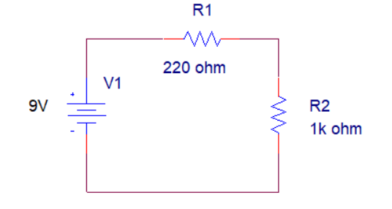
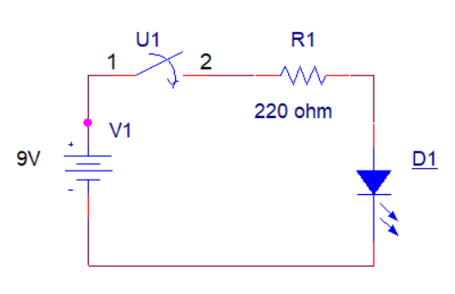
Circuit 1 Circuit 2
U1 is a push button
Activity1. Build circuit 1 and measure the voltage across resistors 1 and 2, they should add up to 9V!
Activity 2. and then build circuit 2. Make sure the TA checks each circuit before you leave .

